Slide 1
Groundwater Reform in Australia
An overview
Groundwater Reforms in Australia and New South Wales
New Delhi – September 2015

Slide 2
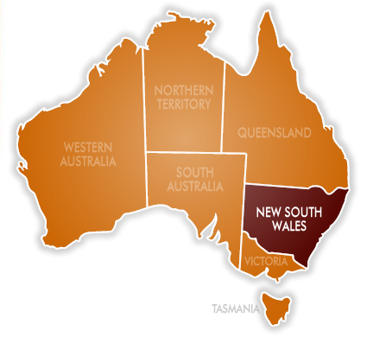
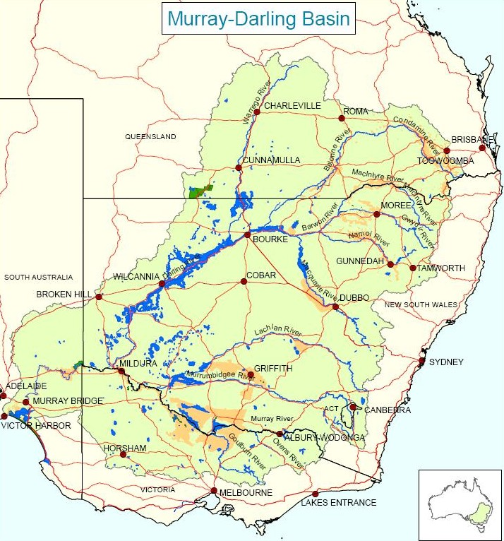
NSW and the Murray- Darling Basin
Australia
7.68 square kilometres
23.6 million
New South Wales
802 square kilometres
6.9 million (9.5/sq km)
78% live in 3 coastal cities

Slide 3
Water resource development in Australia 1900 - 1950
Settlement and development
Construction of dams and weirs for settlement / transport
Establishment of government irrigation areas
Water legislation

Slide 4
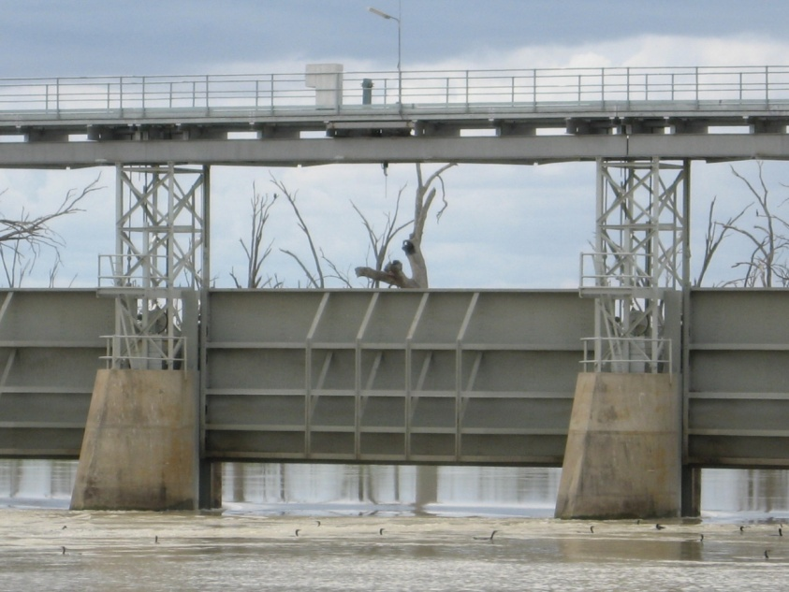
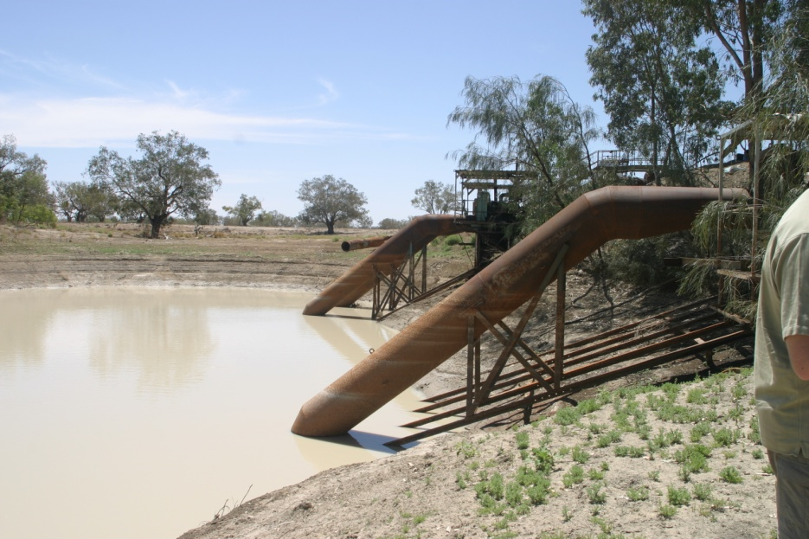
Water resource development 1950 to 1980
Promoting economic development through water use
Construction of large dams for irrigation
Allocation of entitlements for water use

Slide 5
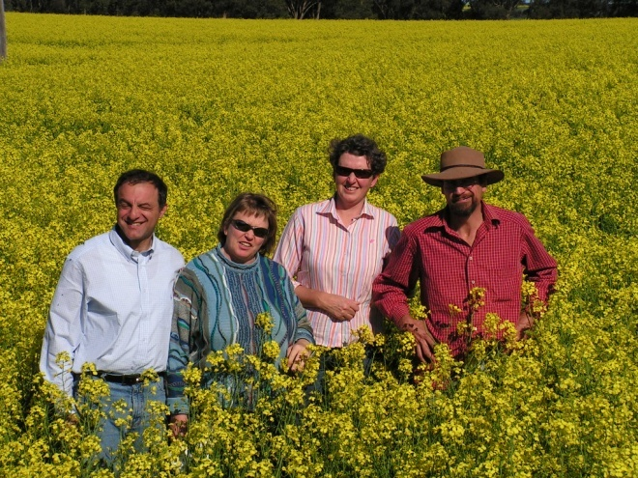
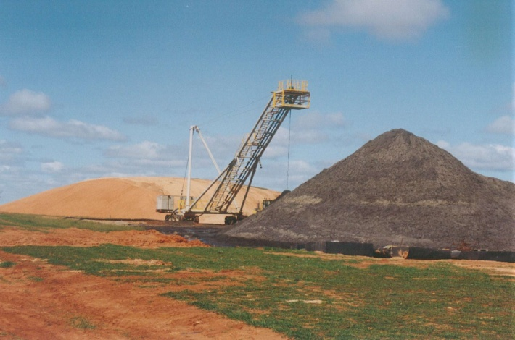
Water resource development 1980s to present
Balancing economic, social and
environmental outcomes
addressing salinity - issues of concern
establishing cross-border management
capping diversions
increased Federal government input
National water reforms

Slide 6
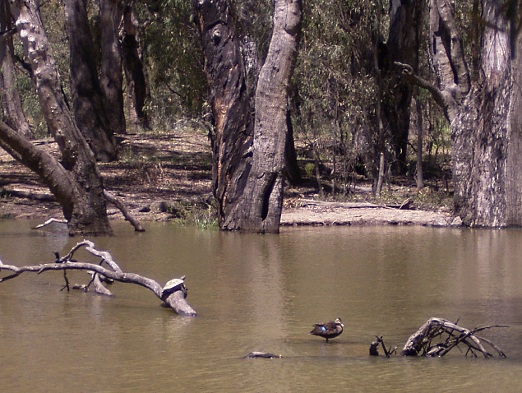
Water reform and governance
National policy
States responsible for management of surface water and groundwater
Sharing through interstate water
agreements
Federal Water Act 2007
Murray-Darling Basin Plan 2012

Slide 7
National Water Policy Reforms
Council of Australia Governments (COAG)
1994 COAG reforms
- reduction in diversions
- clearly defined entitlements
- separation of water rights from land
- removal of barriers to trade
- requirement for water planning
- recovery of costs of managing water

Slide 8
National Water Initiative
COAG reiterated 1994 policy and called it the National Water initiative
Established the National Water Commission
- audit implementation
Federal funding through Australian Water Fund

Slide 9
New South Wales context

Slide 10
Water Use in NSW Average annual use = 7,000 GL
27 power stations
200 mining operations
65,200 square kilometres of agriculture land
Total value of agriculture production = $10 billion
940 square kilometres of irrigated land (1.5%)
Value of irrigated agriculture = $3 billion (30%)

Slide 11
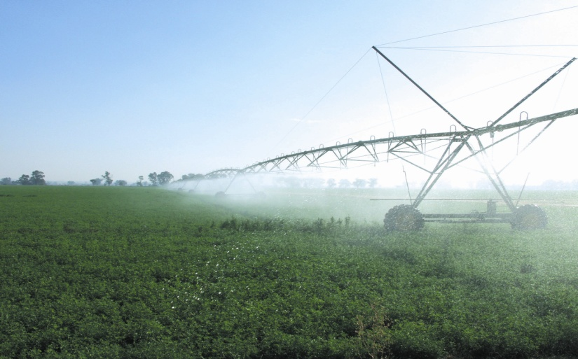
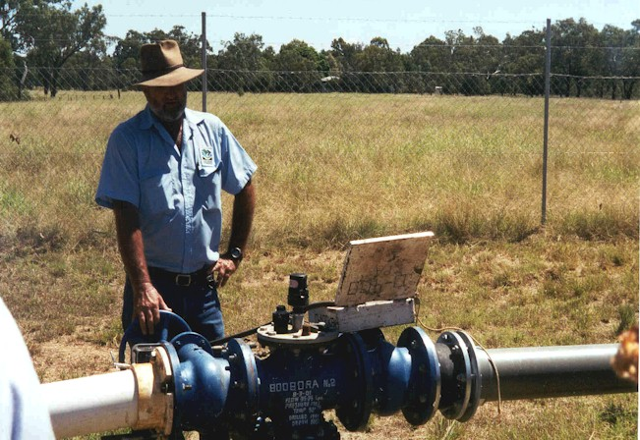
Water use in NSW
Average of 7,000 GL used per year
27 power stations
200 mining operations
75-80% water used in agriculture production
65,200 square kilometres of agriculture land
total Value of Agricultural Production is $10 billion/year
940 square kilometres of irrigated land (1.5%)
value of irrigated agriculture is $3 billion/year (30%)

Slide 12
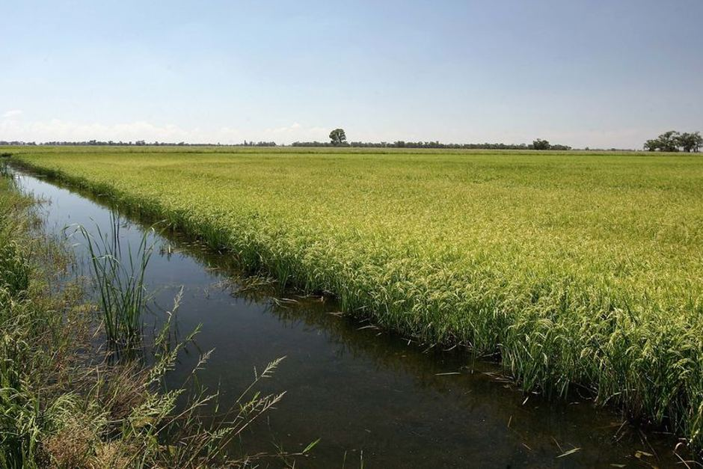
Groundwater allocation process
Aquifers modeled to determine a water balance
- storage
- recharge
- river-aquifer interaction
Low interaction
- total entitlements = proportion of recharge
High interaction
- history of use
- linked to surface water

Slide 13
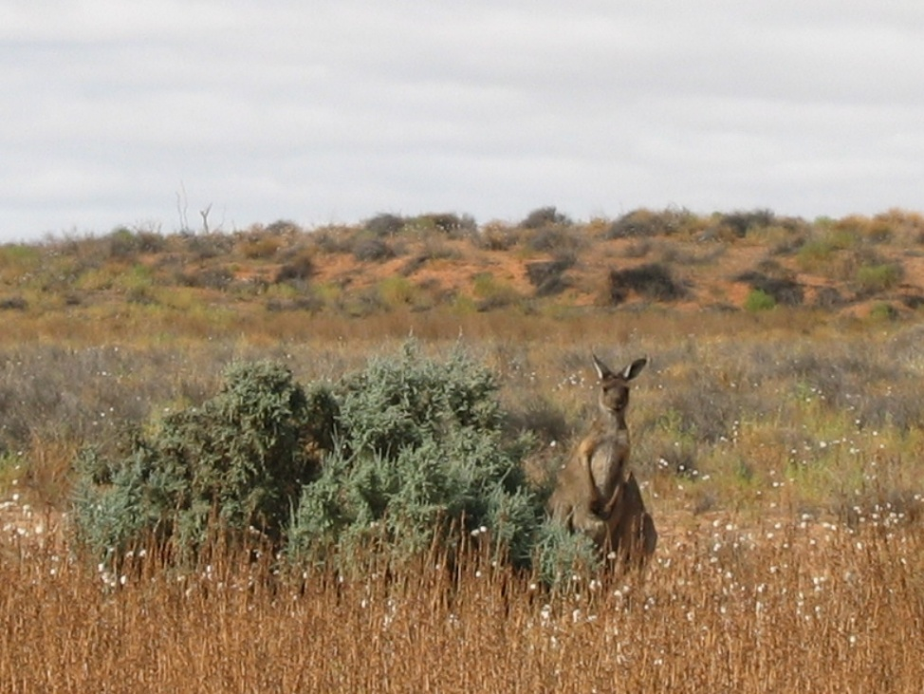
NSW groundwater entitlements
Issued under the NSW Water Act 2000
Volumetric entitlements (previously authorised area)
Extraction is metered
Compliance
- up to $2.2million for corporation
- up to $1.1million for an individual

Slide 14
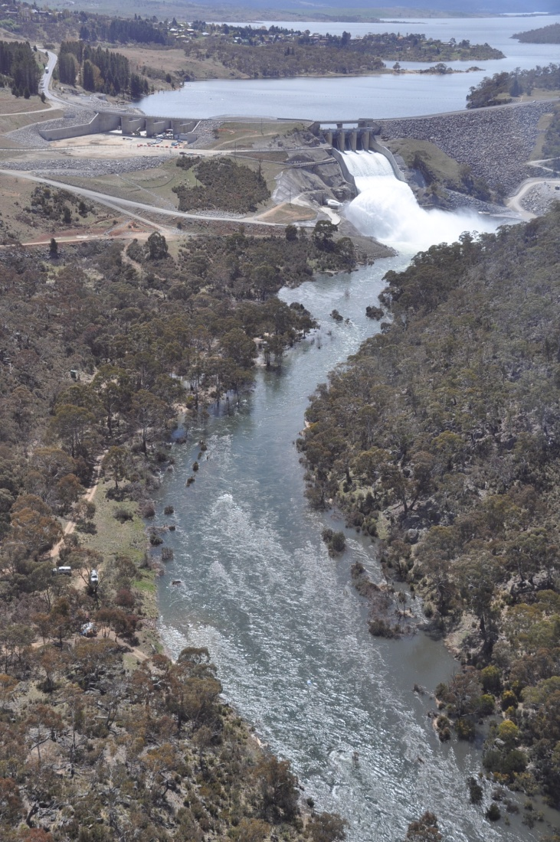
Key outcomes for groundwater in NSW
Legislation introduced
Perpetual water licences listed on Government register
Water entitlement separate from land
Basic landowner rights established
10 year statutory water sharing plans developed by communities
942 GL reduction of entitlements in over-allocated aquifers
Free flowing bores capped

Slide 15
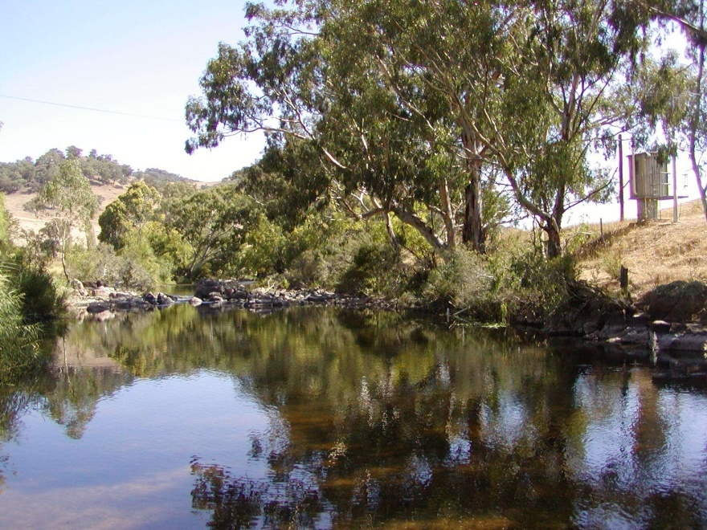
Federal government role
Limited role in issuing or approving entitlements
Approve or refuse major developments based on environmental issues
Established sustainable diversion limits for aquifers in the Murray-Darling Basin

Slide 16
Summary
States responsible for water management
National policy direction through Council of Australian Governments and National Water Initiative 2004
Priorities the long term sustainability for economic, environmental, and social outcomes
Sustainable extraction based on proportion of recharge

Slide 17
Summary continued
Groundwater entitlements issued under legislation
Community driven water planning
- underpinned by technical support
Cooperative Federal-State arrangements
- Federal : policy / funding / audit
- State : implementation / funding / consultation

Slide 18
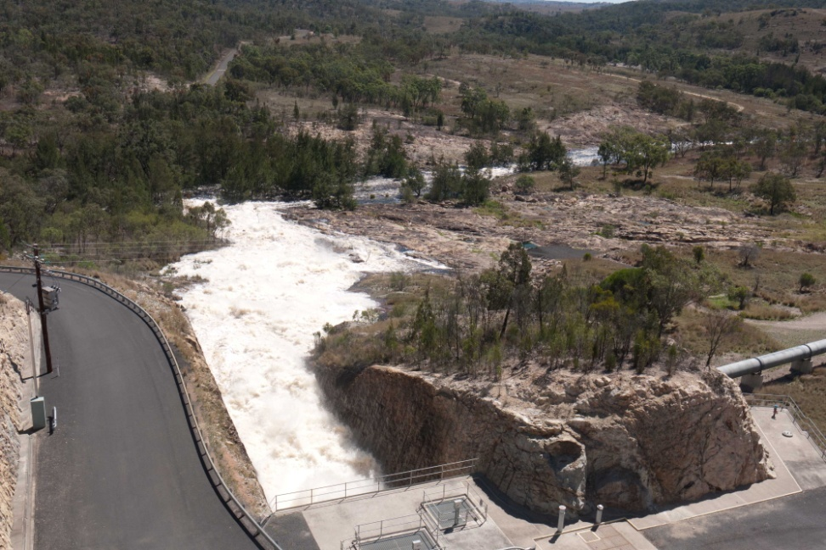
Conclusion
Policy and institutional arrangements developed for Australian conditions
Have our own issues to consider and appreciate cooperation
THANK YOU

